Slide 1
The Clean Energy Investment Challenge for SE Europe
Eurelectric Power Summit 2018
Ljubljana
June 4-5, 2018
Talking points by Mr. Costis Stambolis
Executive Director, IENE
INSTITUTE OF ENERGY
FOR SOUTH EAST EUROPE

Slide 2
The SE European Region Defined

Slide 3
Key Regional Energy Issues
Marked divergence between EU and SEE energy strategies
SEE is more energy security vulnerable than the rest of Europe
Energy supply diversification in SE Europe is less important than security of energy transportation and transmission (oil, gas and electricity)
SEE’s high hydrocarbon dependence
Electricity’s newcomer gas alters supply balance
Lack of adequate electricity and gas interconnections
Coal is and will continue for sometime to be relevant
SEE’s path towards decarbonisation is difficult and uncertain
Nuclear remains a viable option for SEE power generation
RES growth impeded due to policy failures, financial and regulatory framework and electricity grid constraints
Energy poverty is emerging as a regional concern mainly related to deteriorating social conditions

Slide 4
Energy Market Integration and Transition in SE Europe (I)
As the economies of SEE countries are catching up with those of the rest of Europe, energy plays an important role both from financial/investment perspective but also because of market development (i.e. liberalization, competition, etc.)
Although considerable progress has been achieved in recent years on energy market integration, the region faces today serious challenges when it comes to adapting its energy systems and energy markets to meet EU basic targets (i.e. decarbonization, RES penetration, energy efficiency)
Today, we observe great divergence in the degree of adaptation between the different country groups of the region. EU member states having achieved market integration to a large extent with further progress ahead, while West Balkan countries, with the help of Energy Community, trailing behind but on a firm footing as their regulatory authorities and other institutions are now taking the lead.
In today’s exposition, we are greatly assisted from the work undertaken by IENE in its latest “SEE Energy Outlook 2016/2017”, published late June 2017. A tremendous amount of data and analysis is contained in this publication which helps us understand the economic and energy dynamics of the region.

Slide 5
Energy Market Integration and Transition in SE Europe (II)
If we look at the region as a whole, we observe the following:
Energy market liberalization (electricity and gas) and market integration are moving ahead, but in widely diverging directions.
RES are definitely entering into the country and regional energy mix, but at a slow pace (i.e. less than 1 GW of installed capacity in 2017, excluding Turkey)
Energy efficiency is also moving ahead, but cannot be quantified yet, with hundreds of projects under development in all countries. It is not at all sure that EU’s goal for 27% energy efficiency by 2030 will be met.
Electricity grid infrastructure is expanding and upgraded across the region.
However, carbon-based power generation is also moving ahead, adding substantial capacity from now until 2025 (1.5 GW per year for SEE and 2.5 GW for Turkey, i.e. total 4 GW per year over the next 7-8 years).
Carbon-free new nuclear capacity in SEE over last few years is zero.

Slide 6
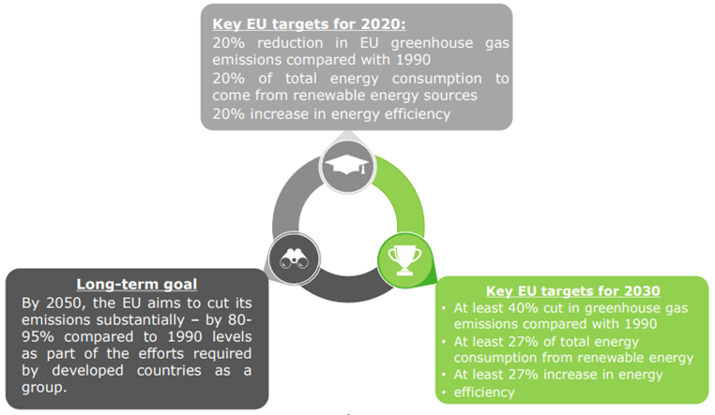
EU Energy Policy Framework (by 2020, 2030 and 2050)
Source: European Commission

Slide 7
EU Energy Policy Framework: How Does This Stand for SE Europe?
It seems that an inverted pyramid arrangement has been developed in SE Europe, compared to pursued official Energy Union policies and stated targets as economic development at all costs remains number one priority for most countries.
The energy policy priorities in broad terms for SEE would appear as follows:
Further large scale development of coal and lignite resources without any real recourse CCS/CSU provisions and plans
Further development of electricity and gas interconnections in order to maximise cross border trade
Promotion of oil and gas exploration activities (onshore and offshore) aiming towards maximizing production in the mid- and long-term
Further development of renewables in all application areas (i.e. solar, wind, biomass, hydro and geothermal) without necessarily aiming to adhere to specific targets (set by the EU)
Promotion of energy efficiency, focusing primarily on the building sector, incentivized by EU and green fund financing facilities
Diversification of supply routes and suppliers in order to secure future gas supplies
Reduction of CO2 emission levels (least of priorities)

Slide 8
Key Regional Energy Issues – Decarbonisation in SE Europe
Challenges and Trends Towards SE Europe’s Decarbonisation:
The coal predicament of SE Europe – the region’s great dependence on coal-fired power generation vs GHG reduction targets
According to IENE estimates, the share of solid fuels to power generation is anticipated to increase steadily in several countries of the region (most notably in Serbia, Kosovo, Croatia, Bosnia and Herzegovina, Montenegro and Turkey) over the next 10-15 years, as they will struggle to meet increased demand.
FYROM and Serbia are the second most coal dependent countries after Kosovo at regional level, while future proposed lignite-based coal-fired power plants in Bosnia and Herzegovina and Serbia would not be in line with EU climate targets, and thus could downgrade the solar PV, wind, hydropower, and biomass opportunities.
Effective climate change policies in SE Europe have not been implemented so far, but there is still room for change in order to avoid becoming further “locked in” the use of fossil fuels.
In SE Europe, economic development, largely based on the utilization of indigenous lignite/coal resources, will have to be reconciled with COP 21 commitments. Therefore, the planning of clean-cut and compatible long-term energy and economic strategies becomes a real challenge.
A lot more analytical and assessment work (e.g. examine CCS/CCU options) needs to be undertaken before introducing realistic policies for decarbonisation.

Slide 9
Coal Plants in SEE Countries (as of January 2018) (MW)
Note: Includes units of 30 MW and larger
Sources: Endcoal, IENE

Slide 10
Installed RES Capacity (MW) in SE Europe (2016)
Countries | Wind | Solar | Hydro | Deep Geothermal | Bioenergy | Total RES Installed Capacity
Albania | 0 | 1 | 2,033 | 0 | 0 | 2,034
BiH | 0 | 13 | 2,140 | 0 | 0 | 2,153
Bulgaria | 700 | 1,032 | 3,219 | 0 | 64 | 5,015
Croatia | 422.7 | 49 | 2,209 | 0 | 63 | 2,743.7
Cyprus | 157.5 | 85.7 | 0 | 0 | 9.7 | 252.9
FYROM | 37 | 17 | 658 | 0 | 4 | 716
Greece | 2,374 | 2,611 | 3,392 | 0 | 58 | 8,435
Montenegro | 0 | 3 | 671 | 0 | 0 | 674
Romania | 3,130 | 1,372 | 6,730 | 0.05 | 124 | 11,356.05
Serbia and Kosovo | 11 | 13 | 3,074 | 0 | 11 | 3,109
Slovenia | 5 | 257 | 1,295 | 0 | 64 | 1,621
Turkey | 5,376 | 827 | 26,710 | 775 | 395 | 34,083
Total | 12,213.2 | 6,280.7 | 52,131 | 775.05 | 792.7 | 72,192.65
Sources: IRENA (2017), IENE study “South East Europe Energy Outlook 2016/2017”, Athens, 2017

Slide 11
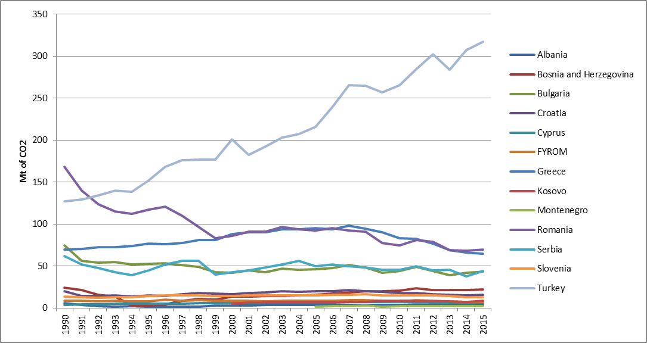
CO2 emissions in SE Europe over 1990-2015
Sources: IEA, IENE

Slide 12
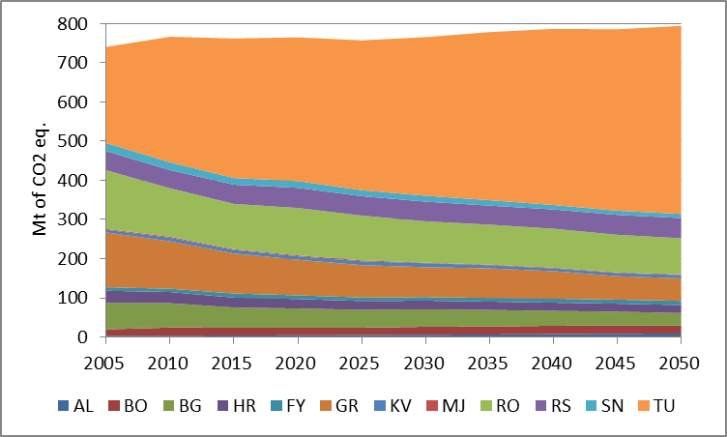
Total GHG Emissions (Mt of CO2 eq.) in SE Europe over 2005-2050
Source: IENE

Slide 13
SEE Energy Investment Outlook 2016-2025
The investment prospects in the energy sector of SE Europe over the next 10 years can only be described as positive.
In terms of planned investments, a group of five countries (i.e. Turkey, Bulgaria, Romania, Serbia, Greece) appear to be moving much faster than others in attracting the needed investment for a variety of energy projects, while progress in the rest of the countries is moving more slowly.
The region as a whole can be considered as presenting attractive business opportunities in almost all branches of the energy sector. The present analysis shows that investment in the energy sector will be spread as follows between countries and interregional projects. This analysis involves two scenarios:
An optimistic one (with an average real GDP growth of 3% over 2016-2025 and maximum investments) and
A reference one (with an average real GDP growth of 1% over 2016-2025 and substantial part of investments) – decarbonization scenario.

Slide 14
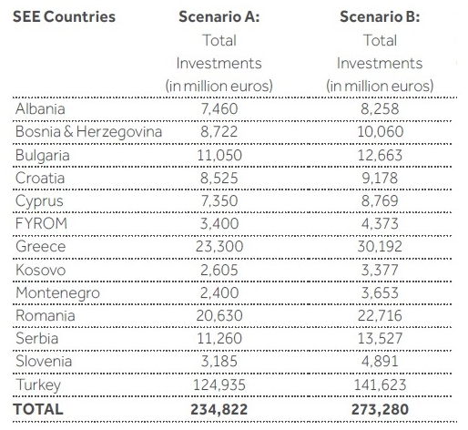
Findings of SEE Energy Investment Outlook 2016-2025 per country
Source: IENE study “South East Europe Energy Outlook 2016/2017”, Athens, 2017

Slide 15
Findings of SEE Energy Investment Outlook 2016-2025 per sector
Source: IENE study “South East Europe Energy Outlook 2016/2017”, Athens, 2017

Slide 16
Thank you for
your attention
www.iene.eu
cstambolis@iene.gr

